Slide 1
Early Results: Sahm and Michez Rule Adjustments for Other Countries
By: Natalie Parker Blount

Slide 2
Why I Switched My Project: What’s Next
Data Sets for Doctor Hiring information too spread out and difficult to get
Too big a project for the time we have
What I’ve Switched to:
Study of the Sahm Rule’s accuracy for other countries adjusted for their labor market and circumstances
Study of labor markets in Germany, France, Finland, and Sweden in comparison to recessions over time and the Sahm + Michez Rule’s predictions
Adjusting the Sahm and Michez rule thresholds to work for different countries, labor markets, and circumstances

Slide 3
Research Question & Positioning
Question: If adjusted for different labor markets, is the Sahm Rule still effective for predicting recessions? If so, how effective?
Professor Michaillat and Professor Saez refine the Sahm Rule into the Michez Rule for predicting recessions using the unemployment and vacancy rates, finding it effective in the US
The Economist put out a research paper/study on the Sahm Rule (unadjusted) and it’s ineffectiveness at predicting recessions in other countries
The paper did not make any adjustment to the Rule, so there are two outcomes:
Even when Adjusted, the Sahm Rule is not effective at predicting recessions in other countries
When Adjusted, the Michez Rule is effective at predicting recessions in other countries

Slide 4
Empirical and Analytical Approach
Sahm and Michez Rule :
  Sahm: the 3-month avg of unemployment minus its 12-month low
  Michez: the decline in the 3-month avg of the vacancy rate relative to its 12-month high. (Higher unemployment + lower vacancies) Take the minimum of the two indicators (i.e., the weaker of the two) to define the Michez indicator. This ensures the signal only triggers when both unemployment is rising and vacancies falling (simultaneous stress in labor market).
Graphing Recession Trends
Adjustments to Sahm and Michez Rules and Thresholds
Testing the Adjusted Models and their Accuracy
Graphing the predictions and Thresholds vs. Actual Recession Data
Data Gathered from OECD on job vacancies, recession, and unemployment

Slide 5
Sahm and Michez Rule Steps
Sahm Rule
  [𝑢 bar(𝑡) = 𝑢(𝑡) + 𝑢(𝑡 − 1) + 𝑢(𝑡 − 2) ]/3
  𝑢̂(𝑡) = 𝑢 bar (𝑡) − min 0≤𝑠≤12 { 𝑢 bar(𝑡 − 𝑠) }
Michez Rule
  𝑣 bar (𝑡) = 𝑣(𝑡) + 𝑣(𝑡 − 1) + 𝑣(𝑡 − 2) 3
  𝑣̂(𝑡) = max 0≤𝑠≤12 { 𝑣 bar(𝑡 − 𝑠) } − 𝑣 bar(𝑡)
Compare results of this test to the timeline of known recessions and adjust the threshold based on those results. If the analysis shows consistent results with the new threshold then the model does work to predict recessions in other countries if adjusted.

Slide 6
Data Presentation
Graph the Recessions for each country
Graph the Michez and Sahm Rule indicators against the Recession Graphs before adjustment
Graph the Michez and Sahm Rule indicators against the Recession Graphs after adjustment
(All graphs are adjusted with available dates and accessibility of the different data, time series for some is longer or shorter depending on accuracy of record)

Slide 7
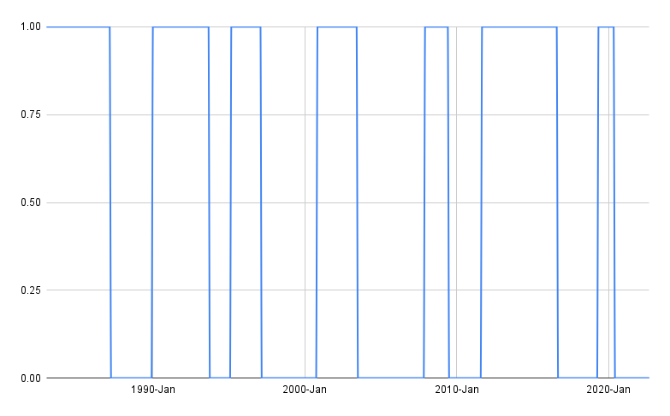
Presentation of Data
Recession Data Chart for France: Will add Michez Rule and Sahm Rule unadjusted and adjusted to similar graphs for each country

Slide 8
Hurdles and Next Steps
Starting my project over has taken a lot of time so I’m rather behind, but my data is gathered
Need to apply and adjust the Michez rule and Sahm rule
Need to Graph them together properly
Finally write my paper, conclusions, possible mistakes or errors, and make my final results project!

